Slide 1
Edited slides of Pallabh Dasgupta and content from Kshemkalyani text book

Slide 2
Lamport-Shostak-Pease Algorithm
Algorithm Broadcast( N, t ) where t is the resilience
For t = 0, Broadcast( N, 0 ):
Pulse
1 The general sends ⟨value, x_{g}⟩ to all processes,
the lieutenants do not send.
Receive messages of pulse 1.
The general decides on x_{g}.
Lieutenants decide as follows:
if a message ⟨value, x⟩ was received from g in pulse-1
then decide on x
else decide on udef

Slide 3
Lamport-Shostak-Pease Algorithm contd..
For t > 0, Broadcast( N, t ):
Pulse
1 The general sends ⟨value, x_{g}⟩ to
all processes, the lieutenants
do not send.
Receive messages of pulse 1.
Lieutenant p acts as follows:
if a message ⟨value, x⟩ was
received from g in pulse-1
then x_{p} = x else x_{p} = udef ;
Announce x_{p} to the other
lieutenants by acting as
a general in
Broadcast_{p}( N – 1, t – 1 ) in
the next pulse
Pulse
t +1 Receive messages of pulse t +1.
The general decides on x_{g}.
For lieutenant p:
A decision occurs in
Broadcast_{q}( N – 1, t – 1 ) for
each lieutenant q
W_{p}[q] = decision in
Broadcast_{q}( N – 1, t – 1 )
y_{p} = majoity (W_{p})

Slide 4
Conclusion
In case of a faulty general all the arrays of the correct processes are the same.
Example: For two correct process Pi and Pk
If Pi has 001101 then Pk too has 001101
In case of a loyal general, all correct process agree on the same value. That is, the subarray compassing of the positions of the loyal lieutanents of every correct process has the same bit (either 0 or 1). Say among the 6 (N) bits the first 4 (first 2N/3) are those of the loyal lieutenants and the last 2 (last N/3 )are of the faulty ones. Then for two correct process Pi and Pk then
If Pi has 111101 then Pk has 111110. The first four bits will be the same for all.

Slide 5
To Prove all correct processes decide on the same value
Two cases: General is loyal
General is not loyal

Slide 6
Loyal general
Lemma 1: If the general is correct, if there are f faulty processes , and if N>2f+t, then all correct processes decide on the input of the general. Lemma 2: Given t, the algorithm is correct if t>=f and there are a total of 3t+1 or more processes.

Slide 7
Features
Termination: If Broadcast( N, t ) is started in pulse 1, every process decides in pulse t + 1
Dependence: If the general is correct, if there are f faulty processes, and if N > 2f + t, then all correct processes decide on the input of the general
Agreement: All correct processes decide on the same value
The Broadcast( N, t ) protocol is a t-Byzantine-robust broadcast protocol for t < N/3
Time complexity: O( t + 1 ) Message complexity: O( N^{t} )

Slide 8
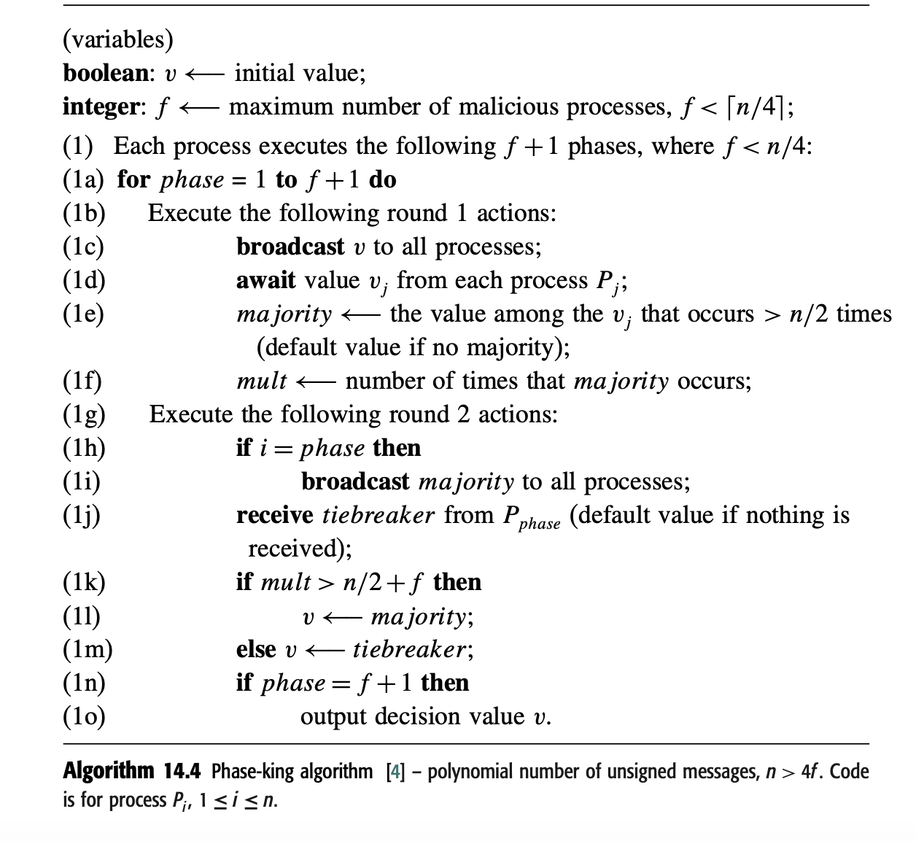
Phase King Algorithm

Slide 9
Proof
There are f+1 phases but only f malicious process hence at least one of the phase kings is non malicious. Let that be for phase K. Consider the three cases that might be true for two non malicious process Pi and Pj. 1. Pi and Pj decided on their majority value at the end of round K
2. Pi and Pj decided on the phase king value at the end of round K
3. Pi decided on majority and Pj decided on phase king value at the end of round K

Slide 10
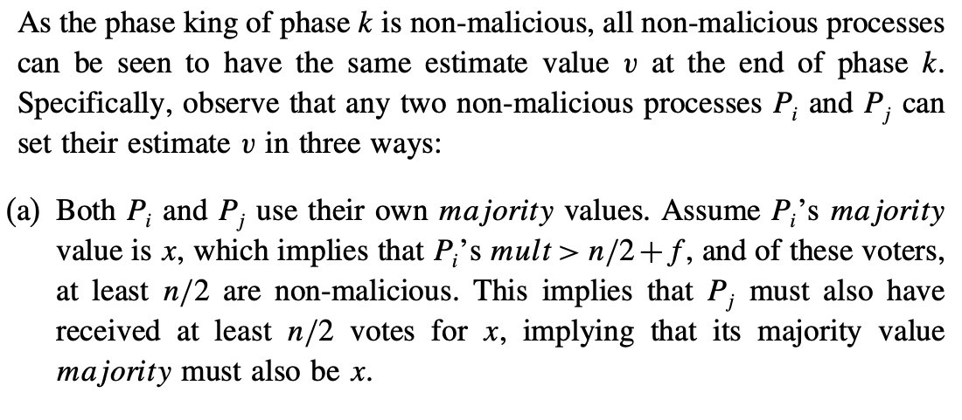
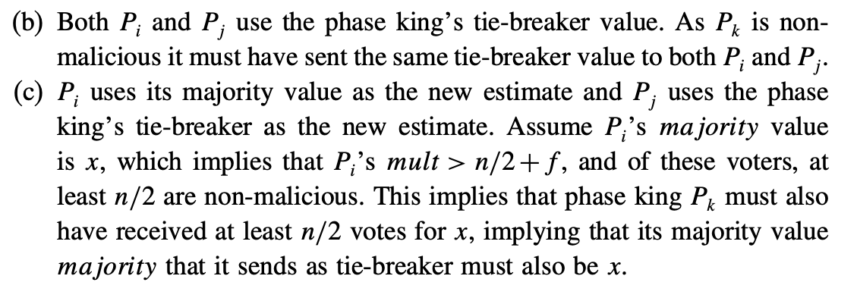
Proof

Slide 11
Proof
Once a non malicious phaseking executes his two rounds; the values of the non malicious processes will not change with any further phase king rounds Going forward, all the non faulty processes already have agreed on a same value. That is more than 3n/4 process now have the same value of v which they send everyone else in round1 of future phases. So all non faulty ppl will get a clear majority of > n/2+f and will continue to decide on their v value.

